Slide 2
Electronic Health Records eConsent
NYHDIF
11th January 2019
Ross Wade
Account Director

Slide 3
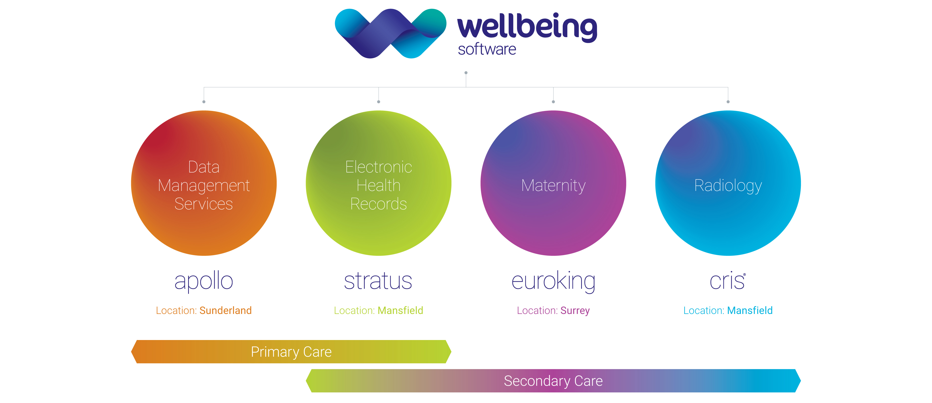
Group Structure

Slide 4
Consent Climate
Legal
Professional Bodies
Care Quality Commission
Paperless NHS Targets (2018-2020)
Montgomery 2015, Pearce 1999
GMC, Royal Colleges
A ‘Fundamental Standard’ - Regulation 11 : Need for consent
Remove nearly 10 million paper forms
NHSLA
Clinical Care Standards : Consent
03

Slide 5
Key Benefits
Clinician
Organisation
Patient
Automated
Complete forms
Healthcare standards
Compliance
Time & cost savings
Fully auditable
Central administration
Paper lite
Electronic signature
Time saving
Fully integrated
Instantly accessible
Clinician orientated
Pre-populated
Guidance based
Digitised
Latest patient information leaflets
Readily available
Individualised
Improved patient experience
No acronyms or abbreviations
Complete document
02

Slide 6
Demonstration

